Slide 1
Category review: Chips
July 2025
Retail Analytics
Brand note: If client logo is not required, use alternate title page layout right click slide thumbnail > Layout > Title

Slide 2
Notes:
To view Privacy video explaining how important data privacy is to Quantium, please click here: https://www.youtube.com/watch?v=Zq1QDAkoRzU
or here Q:\Company Reference\Brand & Design\Brand videos\Q Privacy.mp4
At Quantium, we believe that data is the behavioural footprint of humanity and that it has to be treated with the utmost care and responsibility.
Histories, attitudes, indeed lives are stored within it in ways that aren’t always apparent – and that’s what makes its potential so powerful.
To work with it responsibly, sensitively, we set ourselves the highest data privacy protection and governance standards.
We have spent 17 years perfecting privacy-by-design and secure-by-design principles. Central to this is not holding any personally identifiable information about people –
we neither receive it, and put the necessary protections in place to be unable to decipher it.
Every aspect of handling data is safeguarded: from its de-identification, to its encryption – data security is paramount and of the highest grade.
We pride ourselves on gaining the trust of iconic organisations around the world through years of securely working with their data,
and in turn the trust that builds with their stakeholders.

Slide 3
Executive summary
01
Task 1
Store 77 saw consistent growth in revenue and customers post-trial.
Control store for Store 77 remained flat — confirming impact.
Stores 86 and 88 showed negligible changes.
02
Task 2
Chips are purchased across all segments, but preferences vary by affluence and life stage.
Mainstream-Affluent segments buy more per visit.
Budget-Constrained customers make frequent but smaller purchases.

Slide 4
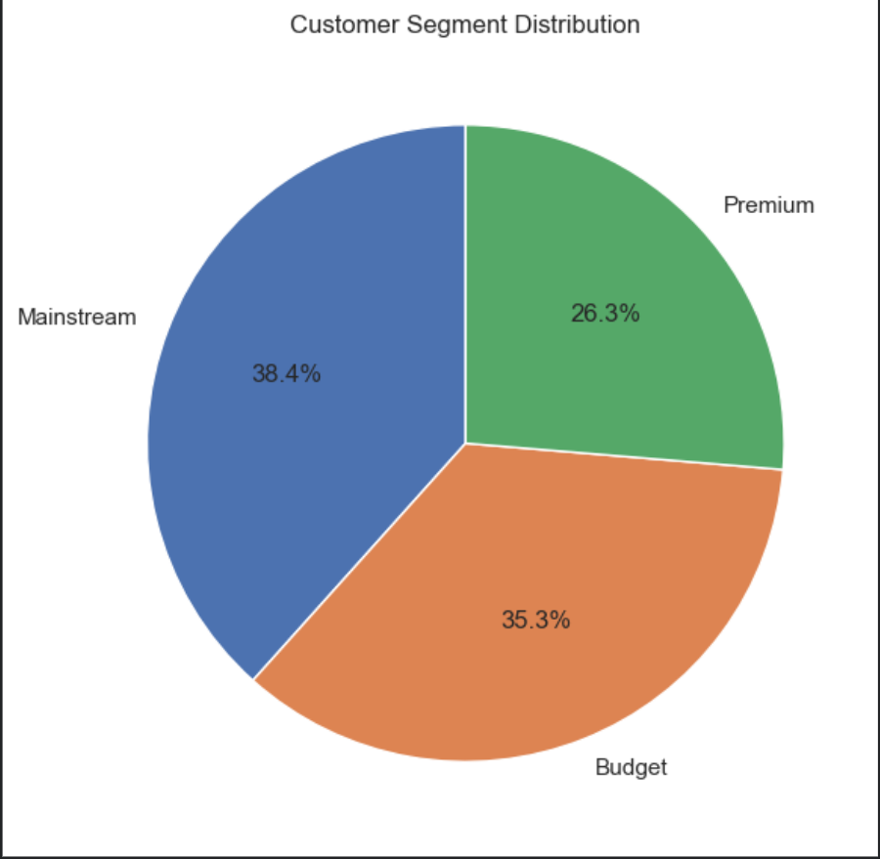
01
Category
Customer Affluence & Life Stage Profile

Slide 5
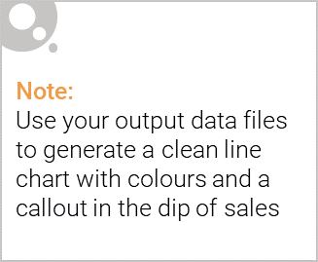
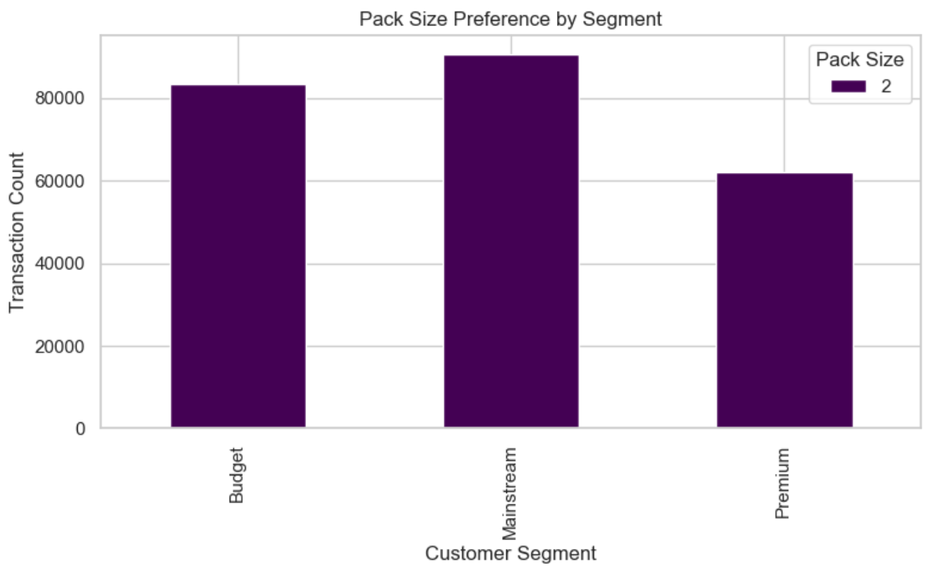
Baseline Sales Revenue Comparison"

Slide 6
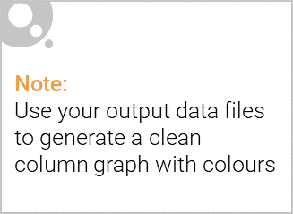
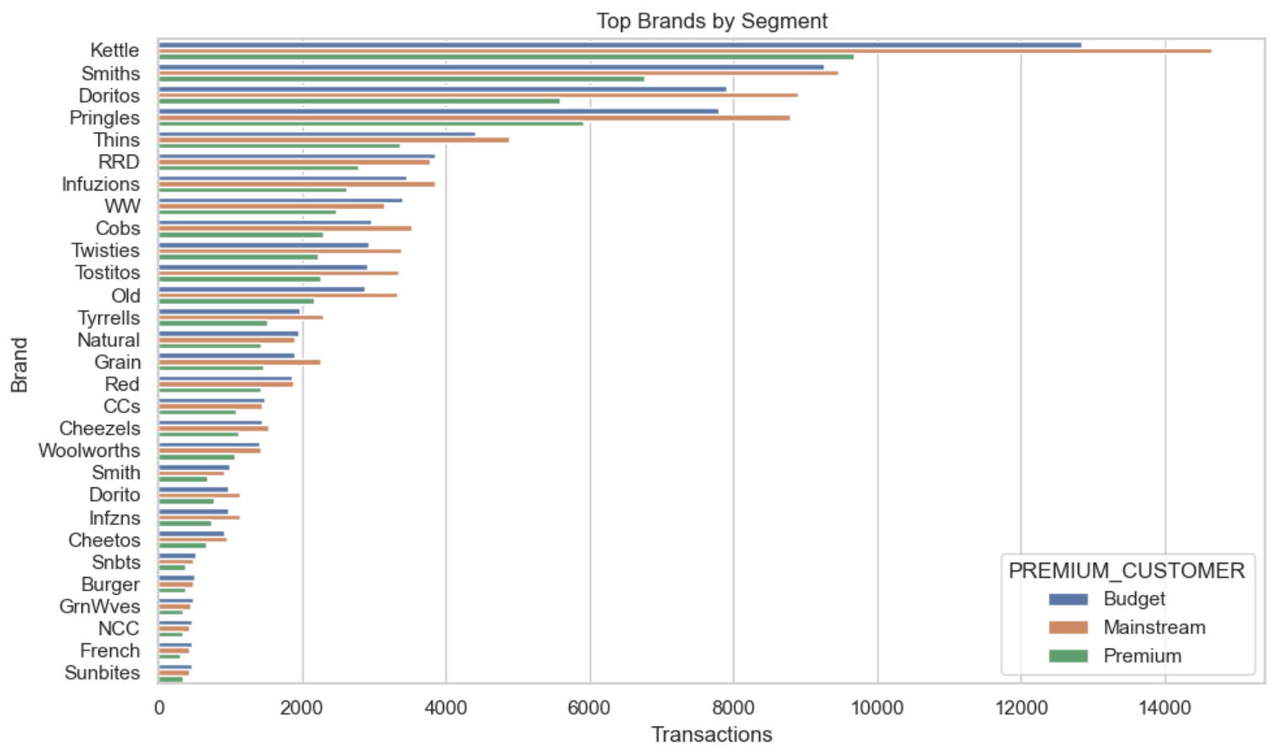
“Trial Period Revenue Performance
Store 77 Performance Shows Clear Lift vs Control"

Slide 7
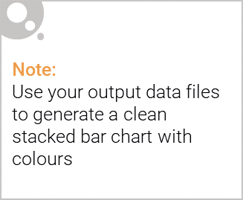
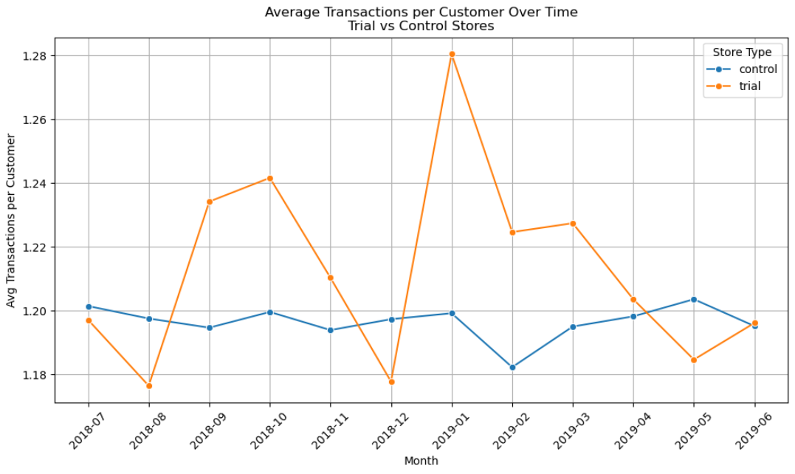
Editable (delete this)
Customer Count Over Time

Slide 8
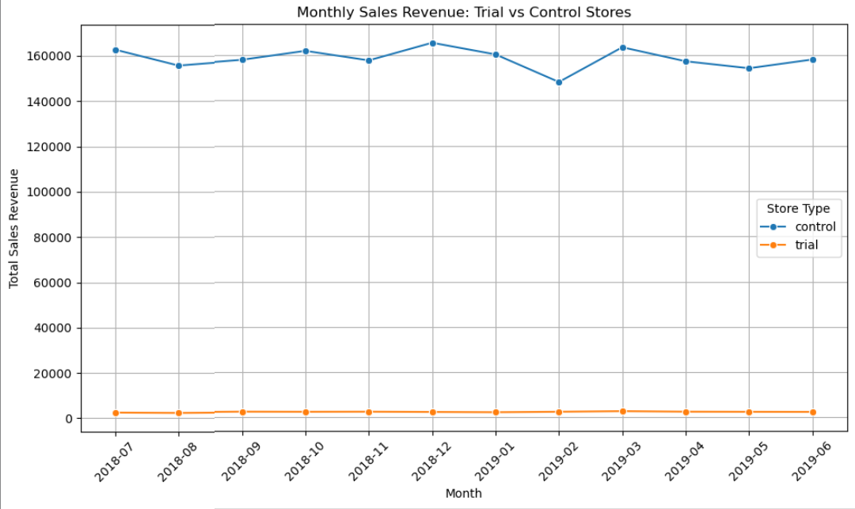
02
Trial store performance
Control store : 77
Trial stores : 86, 88

Slide 9
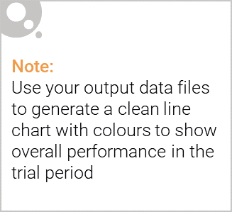
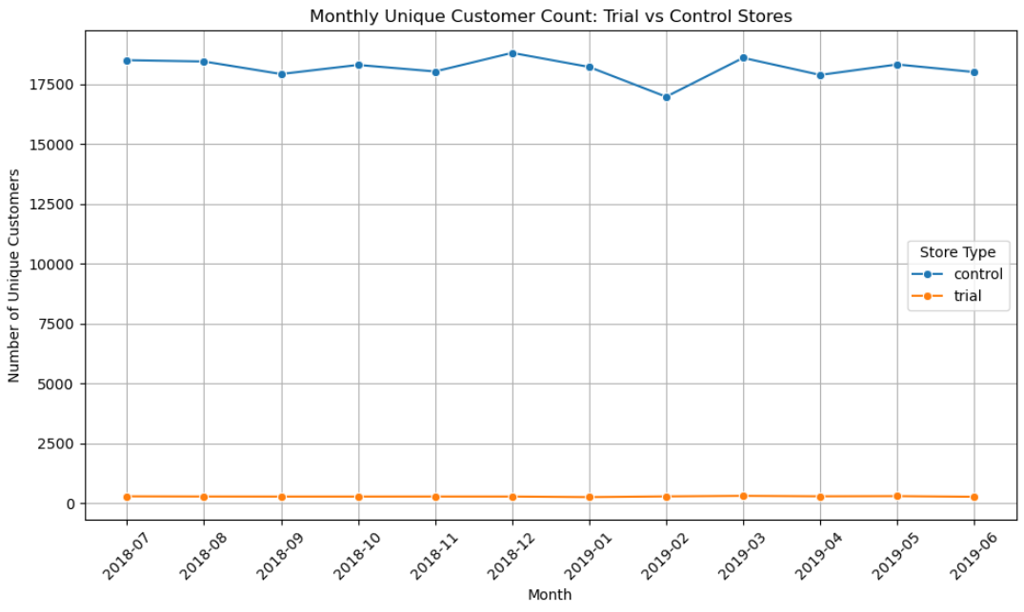
Store 86 & 88 Performance Check

Slide 10
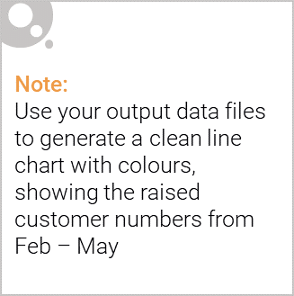
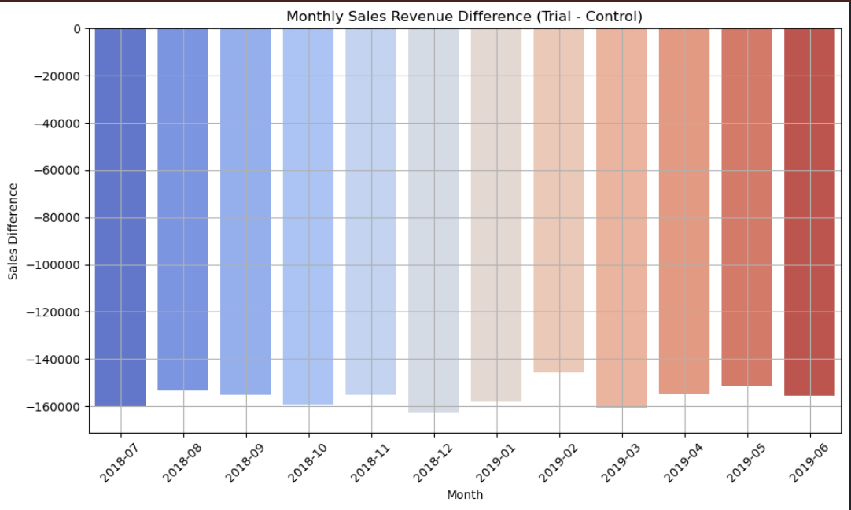
Trial Was Successful: Growth in Sales, Customers, and Basket Size Confirm Impact

Slide 11
Thank you for reviewing this report. Please reach out with any questions or if further analysis is required.
Prepared by: Om Raundal, Quantium Analytics Intern

